Slide 1
MongoDB Aggregation

Slide 2
Introduction To The Mongodb Aggregation Operations
MongoDB aggregation operations allow you to process multiple documents and return the calculated results.
Typically, you use aggregation operations to group documents by specific field values and perform aggregations on the grouped documents to return computed results.
For example, you can use aggregation operations to take a list of sales orders and calculate the total sales amounts grouped by the products.

Slide 3
Mongodb Aggregation Operations
To perform aggregation operations, you use aggregation pipelines.
An aggregation pipeline contains one or more stages that process the input documents
Each stage in the aggregation pipeline performs an operation on the input documents and returns the output documents.
The output documents are then passed to the next stage.
The final stage returns the calculated result

Slide 4
Mongodb Aggregation Operations
The operations on each stage can be one of the following:
$project – select fields for the output documents.
$match – select documents to be processed.
$limit – limit the number of documents to be passed to the next stage.
$skip – skip a specified number of documents.
$sort – sort documents.
$group – group documents by a specified key.
…

Slide 5
Mongodb Aggregation Operations
In this syntax:
First, call the aggregate() method on the collection.
Second, pass an array of documents, where each document describes a stage in the pipeline.

Slide 6
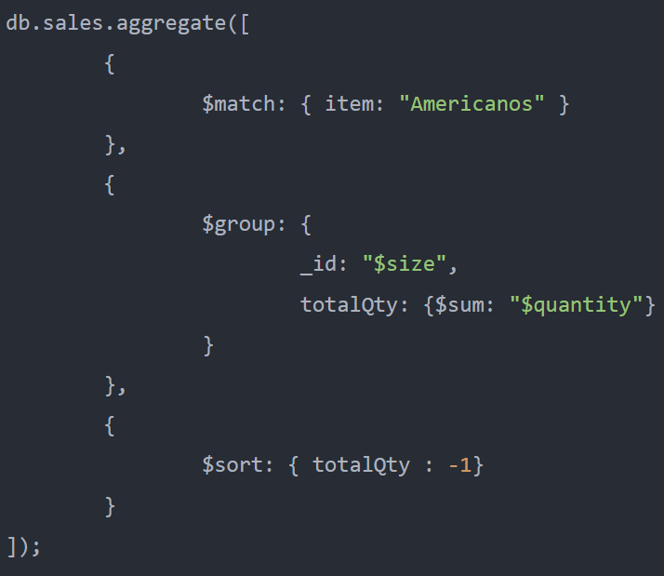
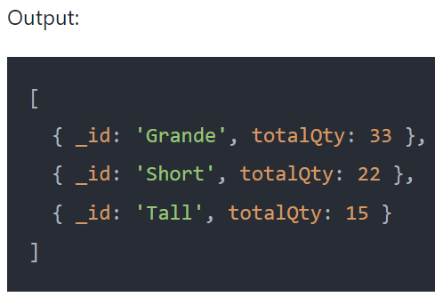
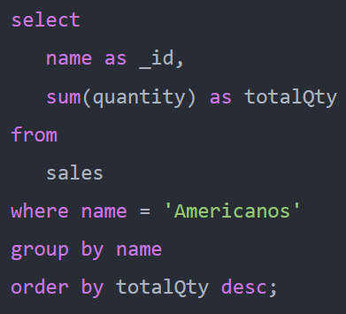
MongoDB Aggregation Example
use coffeeshop.sales collection
use an aggregation pipeline to filter the sales by the Americanos, calculate the sum of quantity grouped by sizes, and sort the result document by the total quantity in descending order
SQL equivalent to MongoDB aggregation

Slide 7
MongoDB Aggregation Example
This aggregation pipeline contains three stages
Stage 1: the $match stage filters the orders by Americanos coffee and passes the filtered documents to the $group stage.
Stage 2: the $group stage groups the filtered documents by coffee size and uses the $sum to calculate the total quantity. The $group stage creates a new collection of documents where each document contains two fields _id and totalQty, and passed these documents to the $sort stage.
Stage 3: the $sort stage sorts the documents by the totalQty field in the descending order and returns the result documents.

Slide 8
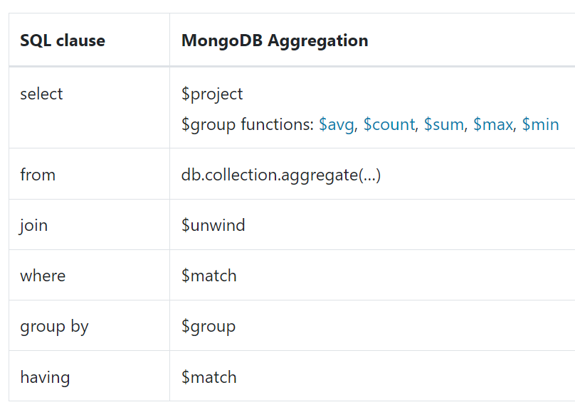
Comparison Between SQL And Mongodb Aggregation

Slide 9

MongoDB $avg
The MongoDB $avg returns the average value of numeric values.
The $avg ignores the non-numeric and missing values.
If all values are non-numeric, the $avg returns null

Slide 10
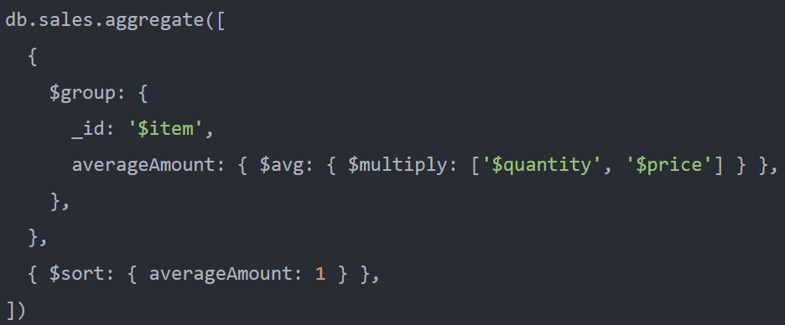
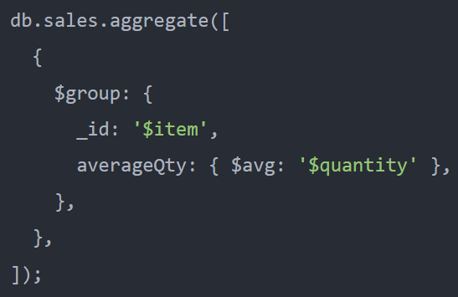
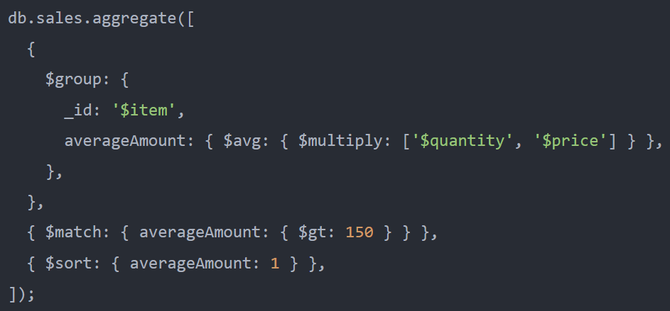
MongoDB $avg - Examples
The following example groups the documents by the item field and uses the $avg to calculate the average quantity for each group
The following example groups the documents by the item field and use the $avg to calculate the average amount for each group
The following example uses the $avg to calculate the average amount per group and returns the group with the average amount greater than 150

Slide 11

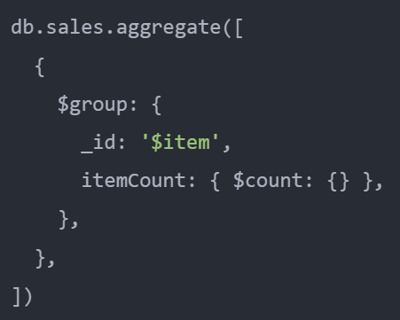
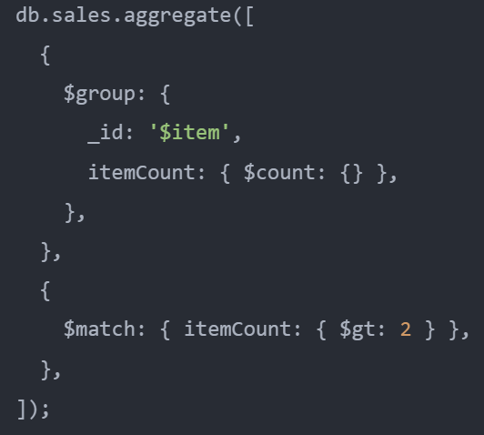
MongoDB $count
MongoDB $count returns the number of documents in a group.
The following example uses the MongoDB $count to return the number of items in the sales collection
The following example uses the $count to calculate the number of documents per item and returns the item with a count greater than two

Slide 12

MongoDB $sum
MongoDB $sum returns the sum of numeric values.
Typically, you apply the $sum to the numeric values.
However, if a field contains a non-numeric value, the $sum ignores that value.
Also, if the field doesn’t exist in any document, the $sum returns 0 for that field.

Slide 13
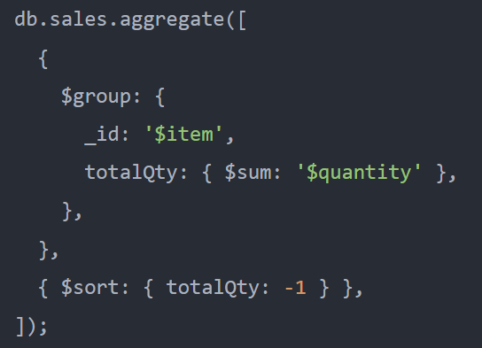
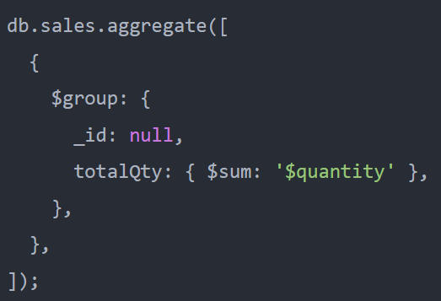
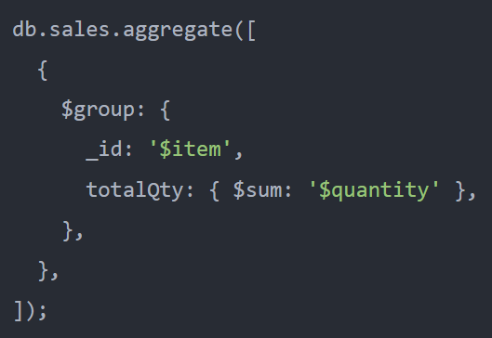
MongoDB $sum - Examples
The following example calculates the total quantity of coffee sales in the sales collection
The following example uses the $sum to returns the total quantity of each item and sorts the result documents by the totalQty in descending order
The following example uses the $sum to calculate the sum of quantity grouped by items

Slide 14
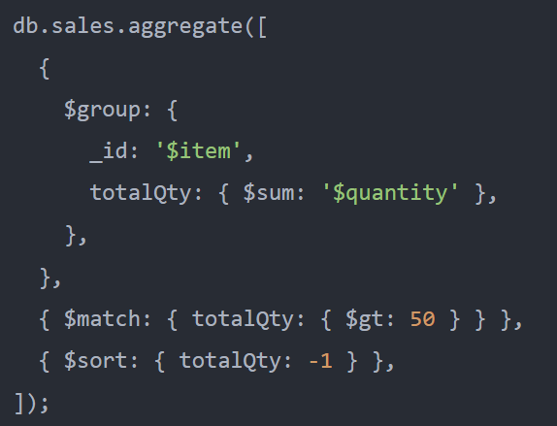
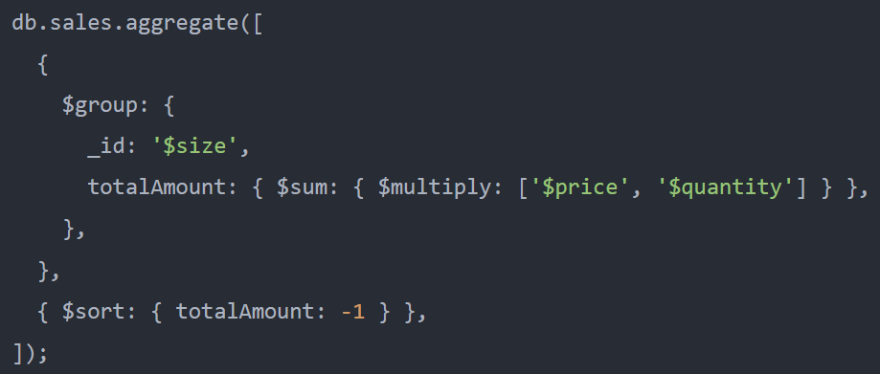
MongoDB $sum - Examples
The following example uses the $sum to return the total quantity of each item and $match to include only items with a total quantity greater than 50
The following example uses the $sum to calculate the total amount by multiplying price with quantity for coffee sales group by sizes

Slide 15

MongoDB $max
The MongoDB $max returns the maximum value.
The $max operator uses both value and type for comparing according to the BSON comparison order for values of different types.
If you apply the $max to the field that has a null or missing value in all documents, the $max returns null.
However, if you apply the $max to the field that has a null or missing value in some documents, but not all, the $max only considers non-null and non-missing values for that field.

Slide 16
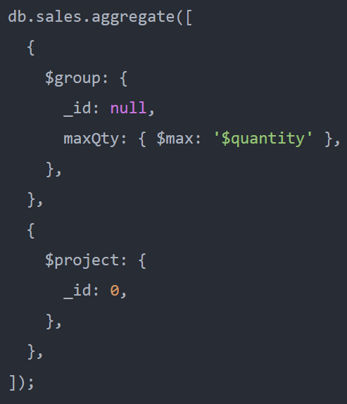
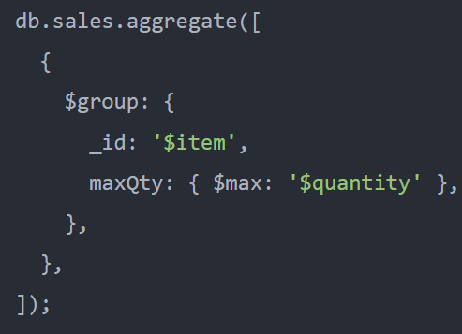
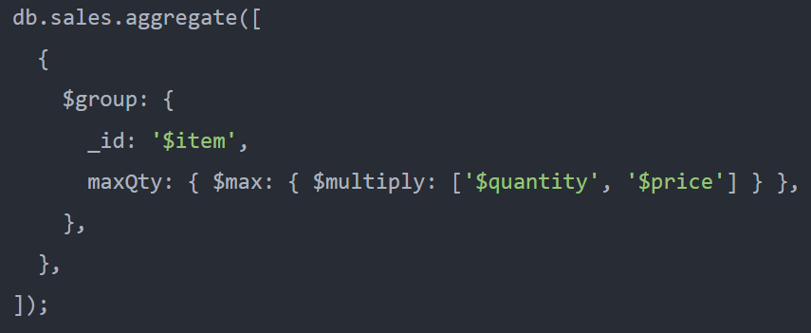
MongoDB $max - Examples
The following example uses the $max to find the maximum quantity from all the documents
The following example uses the $max operator to group documents in the item field and returns the maximum quantity per group of documents
The following groups the documents by the item field and returns the maximum amount for each group of sales

Slide 17

MongoDB $min
The MongoDB $min returns the minimum value.
The $min operator uses both value and type for comparing according to the BSON comparison order for values of different types.
If you apply the $min to the field that has a null or missing value in all documents, the $min returns null.
However, if you apply the $min to the field that has a null or missing value in some documents, but not all, the $min only considers non-null and non-missing values for that field.

Slide 18
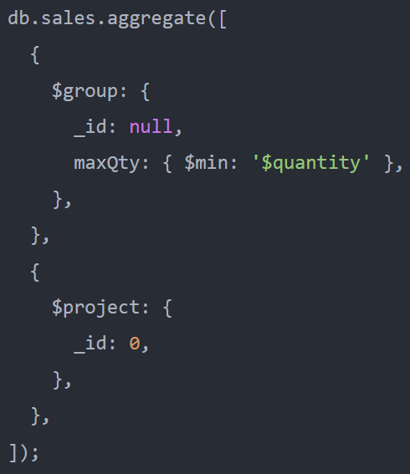

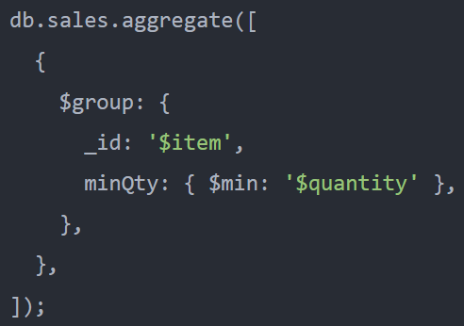
MongoDB $min - Examples
The following example uses the $min to find the minimum quantity from all the documents
The following groups the documents by the item field and returns the minimum amount for each group of sales
The following example uses the $min operator to group documents in the item field and returns the minimum quantity per group of documents

